Slide 1
EMG Emotion Prediction
William Conley | Adrian Fudge | Oluwateniola "Teni" Adegbite Dilan Mian | Alannis Davis
Notes:
Thank you for the opportunity to share

Slide 2

Introduction
Notes:
Affective data science is a subset of data science related to emotions
This involves: Teaching computers to be able to recognize and communicate emotions, sentiment and feelings that people experience
Emotions are multi-faceted – we feel them but have a hard time explaining them
Feelings have different components to them:
Cognitive evaluation (what you’re thinking about)
Physical sensation (what’s physically felt)
Intention (what’s meant to be felt)
A subjective “feeling” (what’s felt)
Interpersonal component (your relationship with the person involved)
Adding to this is an additional layer of complexity: ...
When you consider our…
Tone of voice
Irony
Sarcasm
Homonyms
Metaphors
Figurative speech
All of these things adds layers to the expression of emotions
Studying emotions has grown rapidly using computer models and our improving understanding of them
A key part of affective data science is emotion prediction – trying to use different forms of data to predict an emotional state
This is traditionally run with audio, video, text and more
Our literature review identified that biosignals are a very underrated form of data for these purposes – such as heartrate, respiration, and electromyography

Slide 3
Goals
Create an emotion prediction model that can classify the emotional state for electromyography signals
Determine the effectiveness of electromyography data as a predictor of emotional state
Notes:
Goals:
Create an emotion prediction model that can classify the emotional state for electromyography signals
Determine the effectiveness of electromyography data as a predictor of emotional state

Slide 4
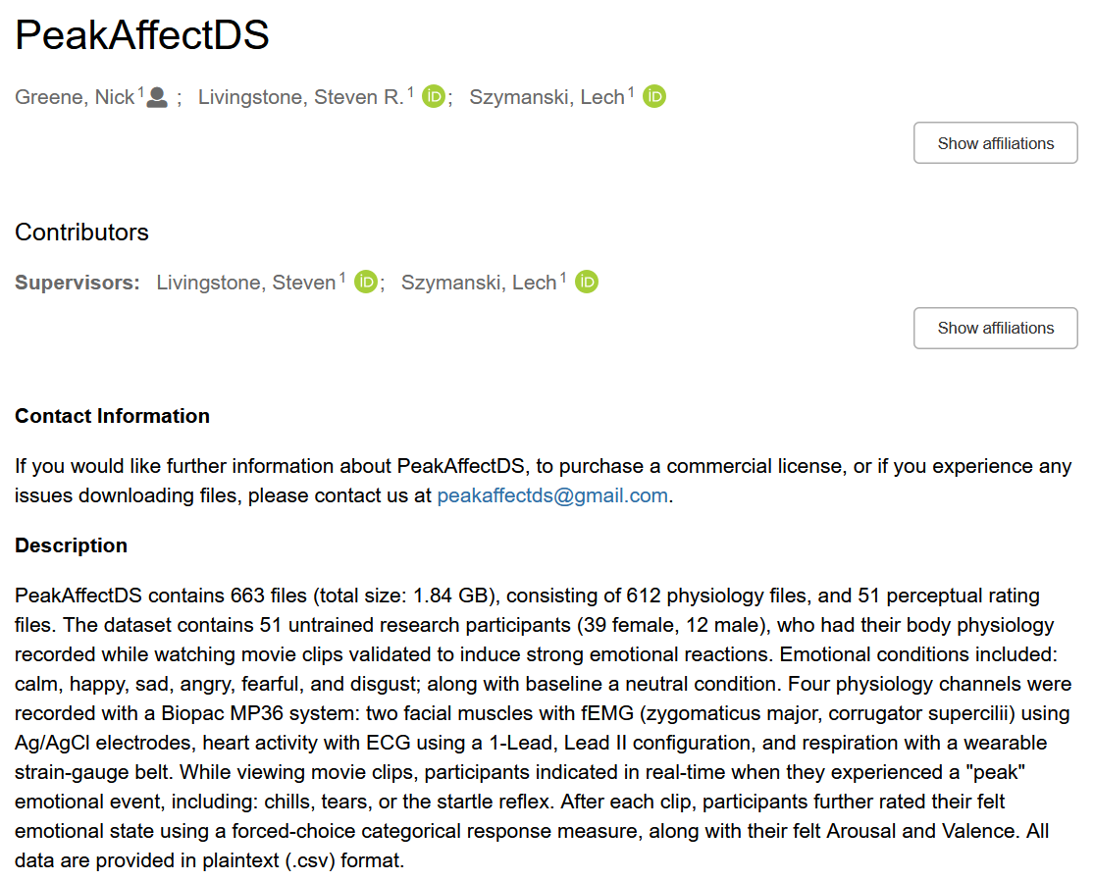
Dataset: PeakAffectDS
Notes:
To fuel our EMG prediction model, we used the PeakAffect dataset – a dataset that contains emotional biometric data
Participants were shown emotional videos with content to trigger: Calmness, Happiness, Sadness, Anger, Fear and Disgust
In between emotional videos, participants were shown Neutral videos to bring their emotional state back to baseline levels
This is comparable to wine tasters cleansing their palettes in between wine tasting, so that their previous experiences don’t taint their sequential experiences
During the videos, the participants biosignals were recorded (with channels such as EMG, EKG and respiration)
It is also important to consider the kind of EMG data being recorded
Just because you have EMG data, you don’t necessarily have a good indicator of emotional state
Ideally, you will want to analyze muscles that are correlated with emotions
PeakAffectDS takes this into account, as it uses the corrugator and zygomaticus muscles
Corrugator: Eyebrow muscles, correlated with raising or furrowing of eyebrows
Zygomaticus: Cheek muscles, correlated with smiling, frowning and more

Slide 5
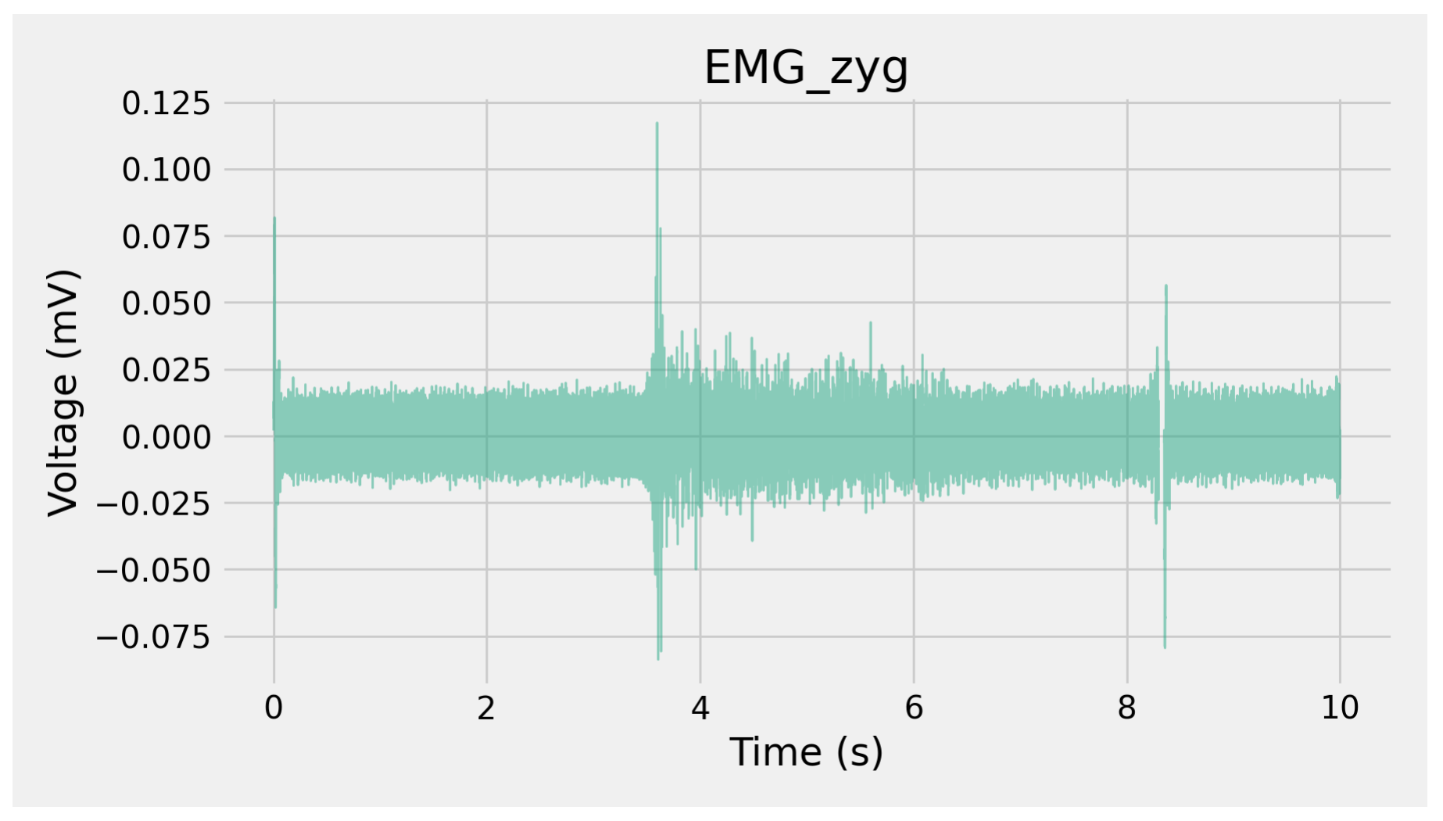
EMG Feature Extraction: EMGFlow
Notes:
Electromyography signals are graphs of the voltage running through your muscles over time
These electrical signals contain messages about the movement of muscles
Can be analyzed to understand their movement
This format presents a problem:
In data science, we typically work with data in tables with features for each instance
Each EMG signal is itself a long table of values
So how do we take this waveform signal and interpret meaning?
There are two ways we could approach this
We could put the entire signal into an LLM and ask it to interpret the meaning
This could work, but has some problems:
We’re not actually learning anything (black box)
This is very resource/time intensive
LLMs can hallucinate
We could use summary metrics as the basis of our decision making
Learn if we are using good predictors or not
Efficient
Machine precision
This is the basis of our decision for using EMG feature extraction software
The next step was to decide which EMG processing software to use
We limited our selection to Python software, as it would integrate with our PyTorch code later for the model
The primary software we considered were:
Neurokit2
Pyemgpipeline
EMGFlow
We selected our EMG processing software based on the number of features it could extract
Neurokit2: Provides a broad range of different biosignals (such as EMG, EKG, respiration, and more) but doesn’t go very deeply in any of them. Only provides 6 very basic summary features
Pyemgpipeline: Only supports preprocessing, does not extract any features
EMGFlow: Provides deep support for EMG preprocessing and feature extraction, offering over 30 features using the latest understanding in EMG features

Slide 6
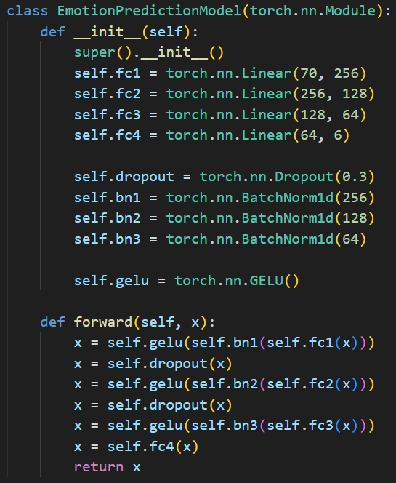
Emotion Prediction Model
Notes:
We built our emotion prediction model using PyTorch – a prominent machine learning package
For our setup, we created several functions, giving us a flexible environment to modify our model as we pleased:
load_data: Load the EMG features into a state usable by the ML algorithm
First, we read the feature file, and load it in as a Pandas dataframe
Next, we split it into a training and testing set, to prevent data leakage in classification
Finally, we convert the training and testing sets into PyTorch dataloader objects, so the classifier can use them
We provide parameters to control the train/test split, as well as the batch size used in the classification model
train_model: Train the classification model
Takes a trainloader object and a model, and runs a training loop
Uses cross entropy loss for criterion, and adam for the optimizer
We provide a parameter for the number of epochs of training to run
Every epoch, we print the loss and accuracy attained
test_model: Test the classification model
Takes a testloader object and a model
Tests the trained model on the test dataset, seeing how it does on new data it has never seen before
Reduces the impact of over-fitting
Prints the final loss and accuracy it attains
Returns a dataframe of the test dataset, showing the true labels compared to the model’s predictions
EmotionPredictionModel: Class controlling the classification model
Built on the standard torch.nn.module architecture
Made up of 4 linear layers with dropout and batch normalization in between each
Takes the 70 features of each EMG recording, reducing it to a class prediction

Slide 7
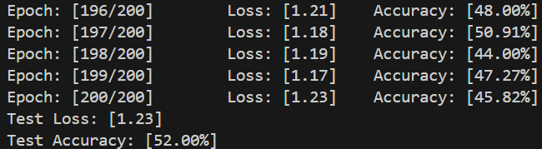
Development Decisions and Fine Tuning
Notes:
Once our environment was set up, we spent time fine tuning the model to improve its accuracy
We also made several observations that helped us trained the model better
Our first model got approximately 40% accuracy – good considering we were classifying 7 different classes
Our first major advancement came from substantially improving the model – we started with a basic 2-layer linear classifier, but after some research were able to make it much deeper
We increased the number of layers and hidden parameters
We added dropout and batch normalization
We used more epochs to train it longer
With this, we were able to bring it up to 60% classification
We also found some additional improvements with using GELU activation rather than RELU
It is described as a better choice for data from sensors
It is more robust to noise, among other technical reasons
We observed that after it was implemented, while we didn’t get higher maximum accuracy, the results were more stable around the upper end
Our biggest observation came from a deeper look at our data
No matter what we did, we couldn’t get past 60% accuracy
After some thinking, we realised we had a critical case of class imbalance
Since neutral stimulus was being used between every two instances of emotional data, it was throwing the prediction off
The prediction model was incorrectly learning to guess “neutral” every time, as it was right half of the time
PeakAffectDS is relatively small, so we determined the best way to address this was to simply remove the neutral data from classification
This brought the accuracy down to 45%, but resulted in more intelligent learning
Our final improvement was to reduce the number of epochs in the training method
This dealt with overfitting, bring the model up to ~52% accuracy, which given our time constraints, we were happy with

Slide 8
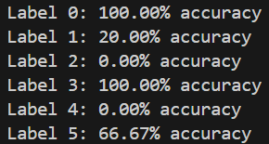
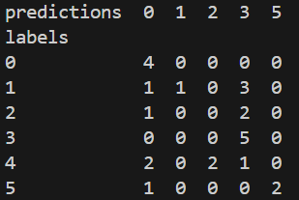
Results
0. Calm
1. Happy
2. Sad
3. Angry
4. Fearful
5. Disgust
Notes:
Our classification model was typically between 48% 52%
This is substantially better than random guessing, considering there are 6 total classes
There is certainly room for improvement, but this is strong evidence to support the idea of EMG as emotional predictors
Looking at the results more closely on a class-by-class basis, we get a deeper understanding
Predictions for “Calm” and “Angry” had 100% accuracy
“Happy”, “Sad” and “Fearful” were easily confused
“Disgust” was fairly accurate

Slide 9
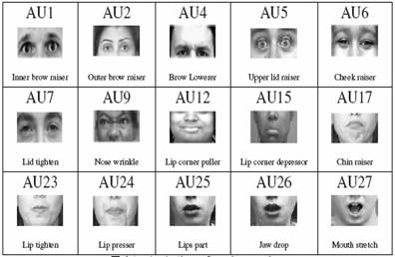
Discussion
Notes:
On further consideration, these findings are consistent with the data we recorded
We have to consider the fact that we are strictly using the mouth and eyebrow muscles to make these predictions
We also have to consider with EMG data, all we can look at is the intensity with which these muscles are moving
Consider “Calm” vs. “Anger”
Typically when “Calm”, you have a resting face with minimal muscle activation
When “Angry”, your eyebrows and mouth move to make an angry face, usually with an intensity
These are the two ends of the extreme of emotions, making them very easy to identify
Now consider “Happy”, “Sad” and “Fearful”
“Happy” and “Sad” are more passive emotions with less extreme muscle movements “Fear” doesn’t typically express itself through movement of mouth or eyebrows
This makes these emotions less identifiable, so they were more easily confused with “Anger” and “Calm”

Slide 10
Conclusion and Next Steps
GitHub: https://github.com/WiIIson/EMG-Emotion-Prediction
Notes:
Overall, our takeaway from this is that electromyography data is a good predictor of emotional state
The key is to use the most relevant muscles to the emotions you want to predict
Some future directions could explore:
Accuracy of using other muscles in emotion prediction
Include other biosignals – PeakAffectDS had respiration and heartrate
Analysis of a larger dataset
Researching further methods of improving the emotional classification model
Thank you for your time

Slide 11
References
Chen, G., Chen, P., Shi, Y., Hsieh, C.-Y., Liao, B., & Zhang, S. (2019). Rethinking the usage of batch normalization and dropout in the training of deep neural networks. arXiv preprint arXiv:1905.05928. https://doi.org/10.48550/arXiv.1905.05928 Shah, V., & Youngblood, N. (2024). Leveraging continuously differentiable activation functions for learning in quantized noisy environments. arXiv preprint arXiv:2402.02593. https://doi.org/10.48550/arXiv.2402.02593 Chawla, N. V., Bowyer, K. W., Hall, L. O., & Kegelmeyer, W. P. (2002). SMOTE: Synthetic minority over-sampling technique. Journal of Artificial Intelligence Research, 16, 321–357. https://doi.org/10.1613/jair.953
Notes:
Batch Normalization and Dropout: https://arxiv.org/pdf/1905.05928
GELU: https://arxiv.org/pdf/2402.02593
Class imbalance: https://www.jair.org/index.php/jair/article/view/10302/24590

